Slide 1

What is Software Engineering?

Slide 2



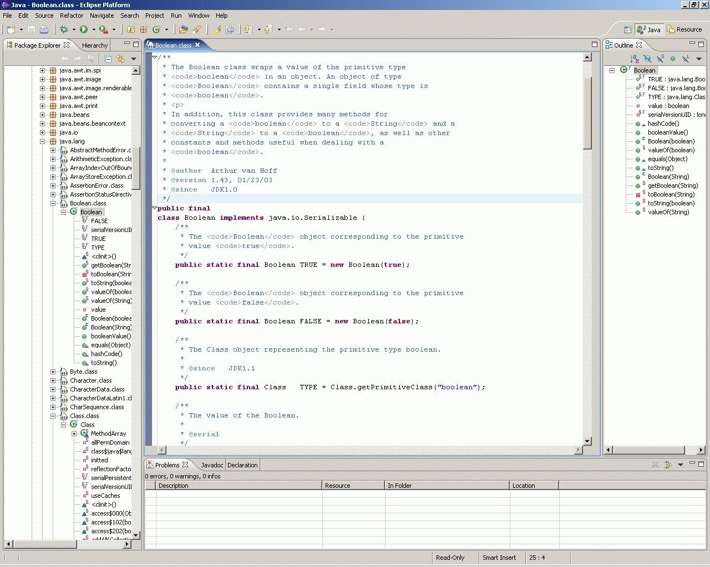
What is Software Engineering?
Developing in an IDE and software ecosystem?

Slide 3

What is Software Engineering?
Developing in an IDE and software ecosystem?
Coding and debugging?

Slide 4
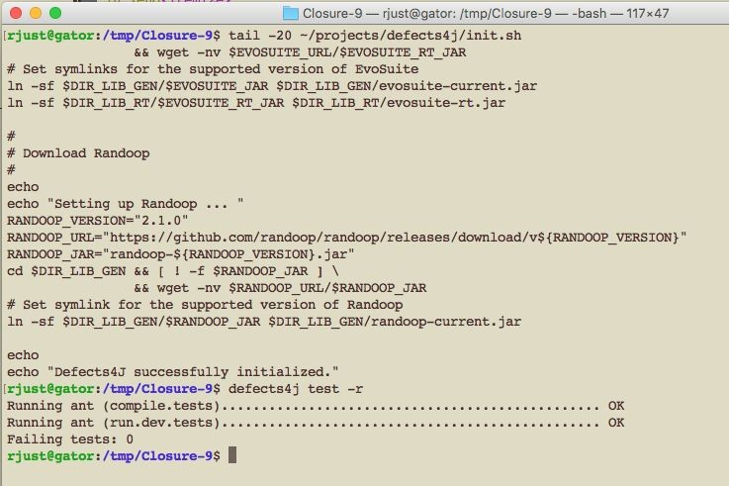
What is Software Engineering?
Developing in an IDE and software ecosystem?
Coding and debugging?
Deploying and running a software system?

Slide 5
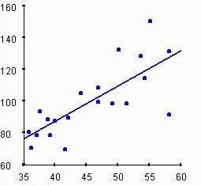
What is Software Engineering?
Developing in an IDE and software ecosystem?
Coding and debugging?
Deploying and running a software system?
Empirical evaluations?

Slide 6
What is Software Engineering?
Developing in an IDE and software ecosystem?
Coding and debugging?
Deploying and running a software system?
Empirical evaluations?
All of the above -- much more than just writing code!

Slide 7
What is Software Engineering?
More than just writing code
The complete process of specifying, designing, developing, analyzing, deploying, and maintaining a software system.
Common Software Engineering tasks include:
Requirements engineering
Specification writing and documentation
Software architecture and design
Programming
Software testing and debugging
Maintenance and refactoring
Just one out of many important tasks!

Slide 8
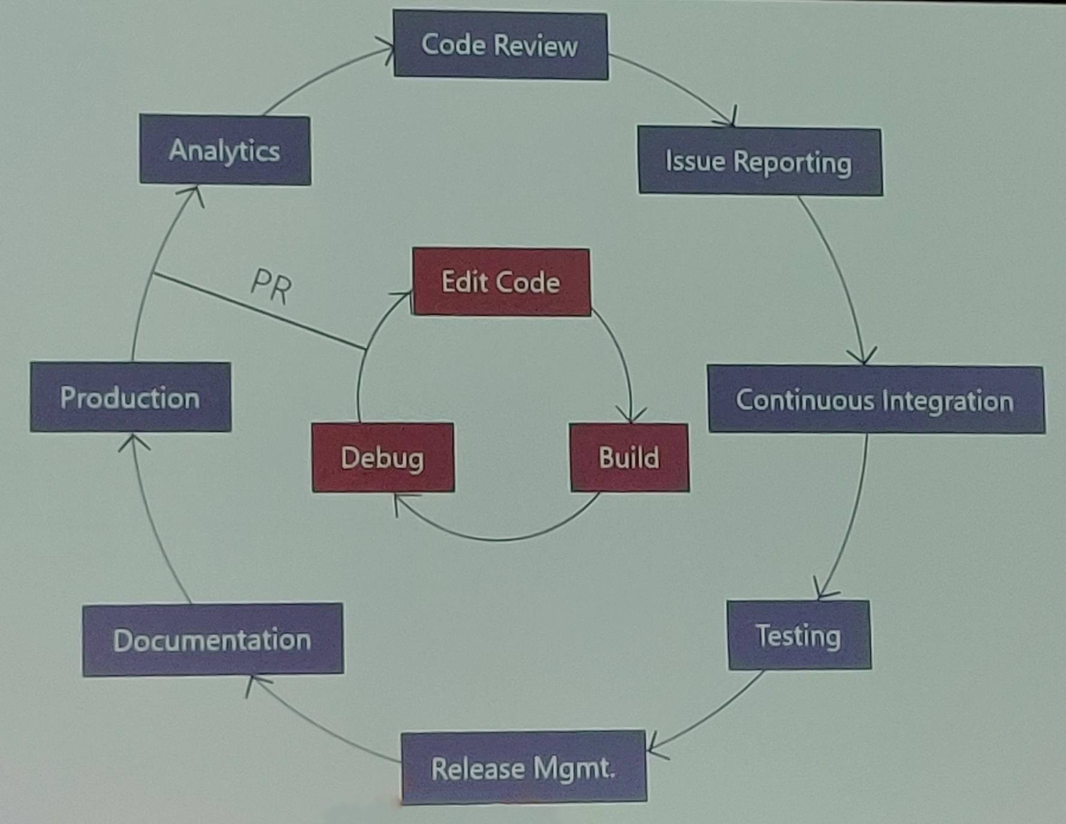
The Role of Software Engineering in Practice
(Development workflow at Microsoft, Big Code summit 2019)

Slide 9
The Role of Software Engineering in Practice
Focus of intro to programming courses. Our goal: go beyond the inner cycle.
(Development workflow at Microsoft, Big Code summit 2019)

Slide 10
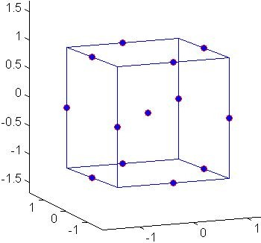
The Role of Software Engineering in Research
Experimental infrastructure is software, too!
1 | 0.34 | 0.81
2 | 0.52 | 0.32
3 | 0.21 | 0.53
4 | 0.81 | 0.22
... | ... | ...
Infrastructure
Design space exploration
Example (automated debugging)
150 configurations, 1000+ benchmarks
1-85 hours per execution
200,000+ CPU hours (~23 CPU years)
Software bugs can lead to wrong scientific conclusions.

Slide 11



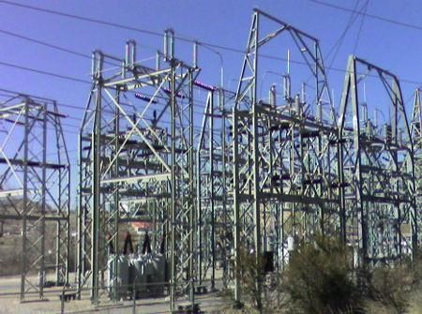
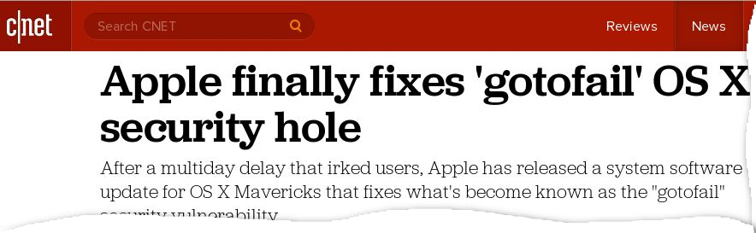



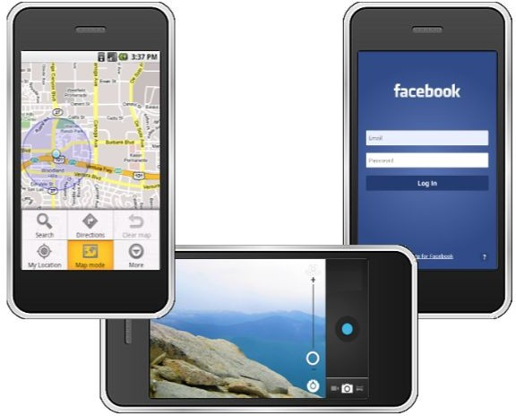
Why is Software Engineering important?
Software is eating the world!

Slide 12

Why is Software Engineering important?
Software is eating the world!

Slide 13

Why is Software Engineering important?
Software is complex!
~15 million lines of code
Let’s say 50 lines per page (0.05 mm)
300000 pages
15 m (49 ft)

Slide 14
Summary: Software Engineering
What is Software Engineering?
The complete process of specifying, designing, developing, analyzing, and maintaining a software system.
Why is it important?
Decomposes a complex engineering problem.
Organizes processes and effort.
Improves software reliability.
Improves developer productivity.

Slide 15
Course overview: the big picture
Software processes, requirements, and specification
Different software development processes.
Precise writing (requirements and specifications).
Software development
Decompose a complex problem and build abstractions.
Improve your coding skills.
Effectively use version control (Git).
Software testing and debugging
Write effective (unit) tests.
Hands-on experience, using testing and debugging techniques.
Continuous integration.
Class project
Apply all of the above in a group project.

Slide 16
Expectations
Programming experience and familiarity with one programming language (Java, C++, ...).
Active participation in discussions.
Teamwork and communication.
Reflecting on and improving submitted assignments.
You must already know how to program.

